Slide 1
-Fix code on color scale slide
-add explicit x/y/mapping to grammer slide
-Sequencing: -geometries don’t interact or impact each other, scales have global changes
-Be more careful when you say “x” axis and “y axis”
-GDP: is it log transformed or log10 transformed? do you need exp() or some other function to transform?
-Change sorting in excersise to median (instead of mean)
-scale_fill_manual is is “values” instead of “value”
-keep bar plot, but calculate the count using dplyr beforehand, both to show them how that works, and also to avoid having to talk through stats

Slide 2

Visualizing Data
in R using ggplot2
Lauren Nichols
Center for Data and Visualization Sciences – Duke Libraries
Lmn7@duke.edu
Jan 30, 2026
https://tinyurl.com/ggplot2fall25

Slide 3





Data Visualization Specialists
askdata@duke.edu
Lauren
Nichols
McCall
Pitcher
Drew
Keener
mapping
Eric
Monson

Slide 4
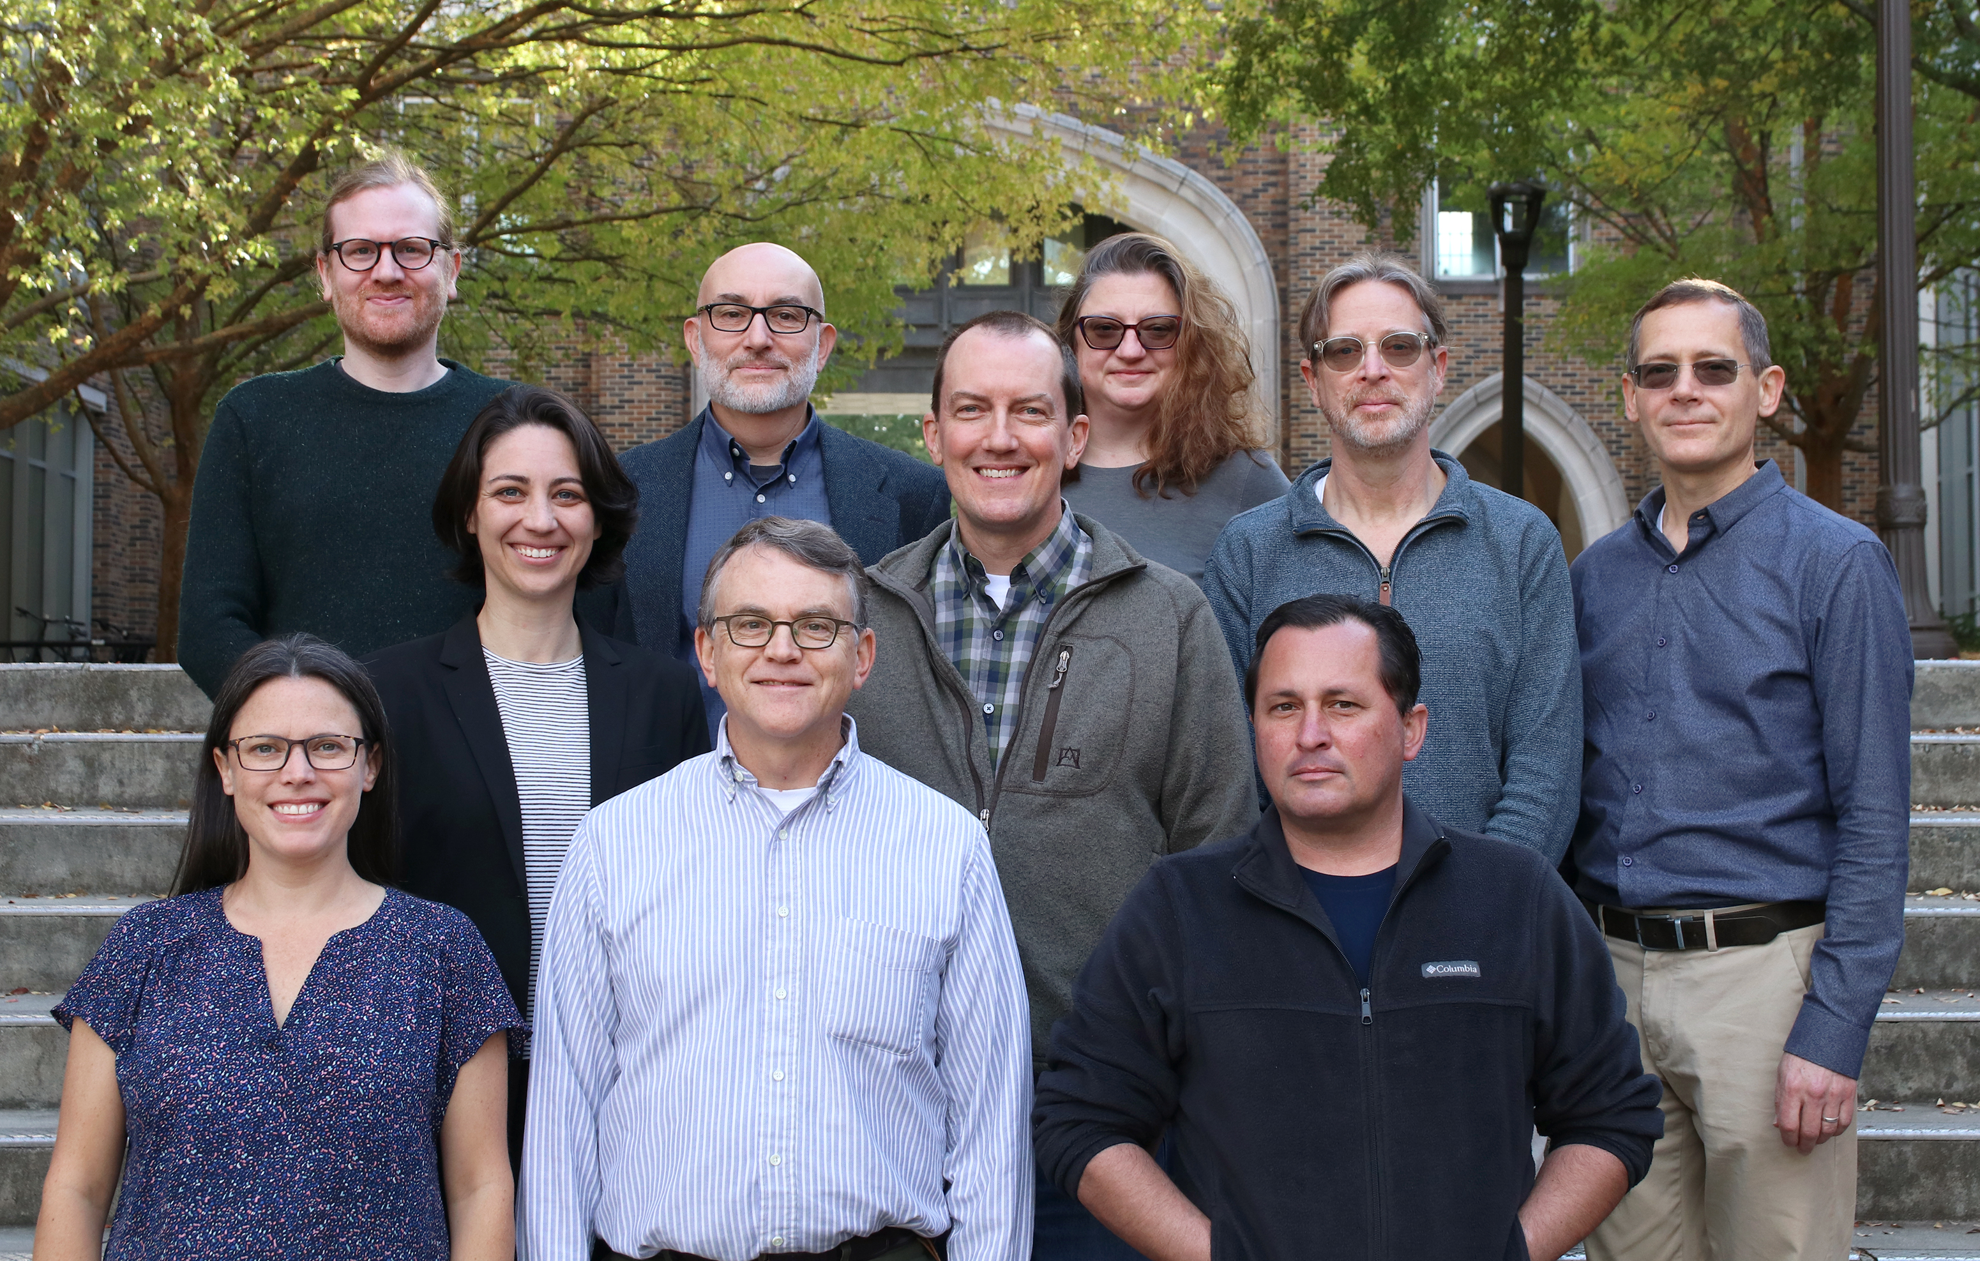
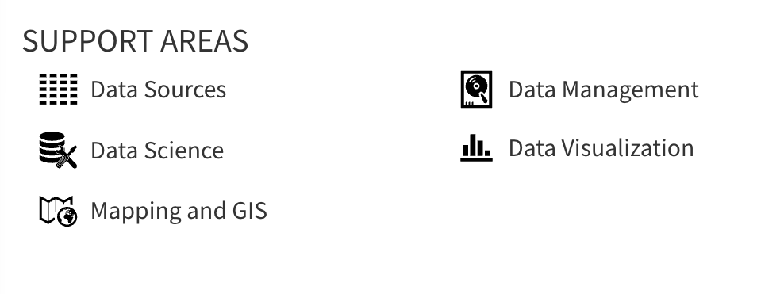
Center for Data & Visualization Sciences (CDVS)
AskData@duke.edu
Notes:
We offer workshops and individual consultation

Slide 5
“gg” in ggplot2 stands for
“Grammar of Graphics”
Notes:
(move it over)

Slide 6
Data
Aesthetics
Geometries
Statistics
“gg” in ggplot2 stands for
“Grammar of Graphics”
Graphics are built by layering elements
Scales
Themes
Notes:
framework that follows a layered approach constructing visualization. It allows us to buid visualizations in a structured and methodical way.

Slide 7
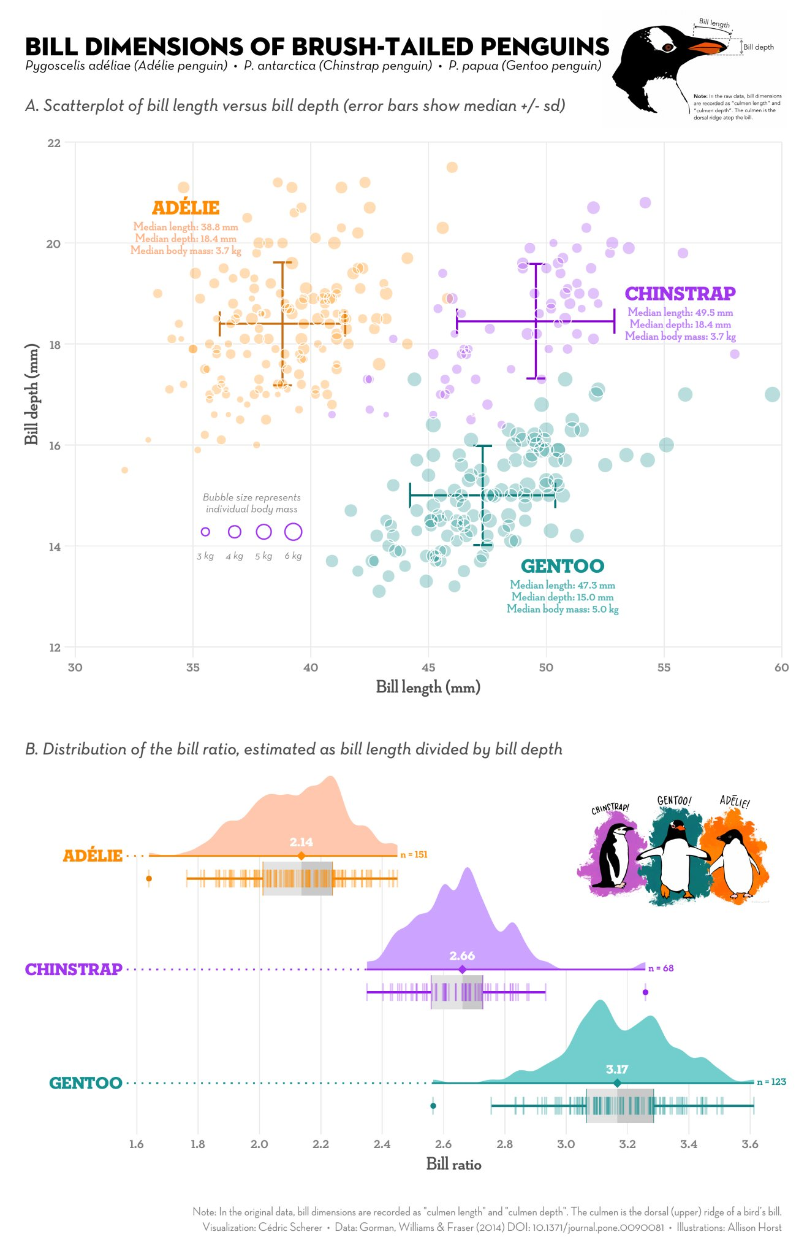
Notes:
Versatile – customize visualizations
Publication ready graphics
(or at least pretty close to it)
Integration with analysis in R
Succinct

Slide 8
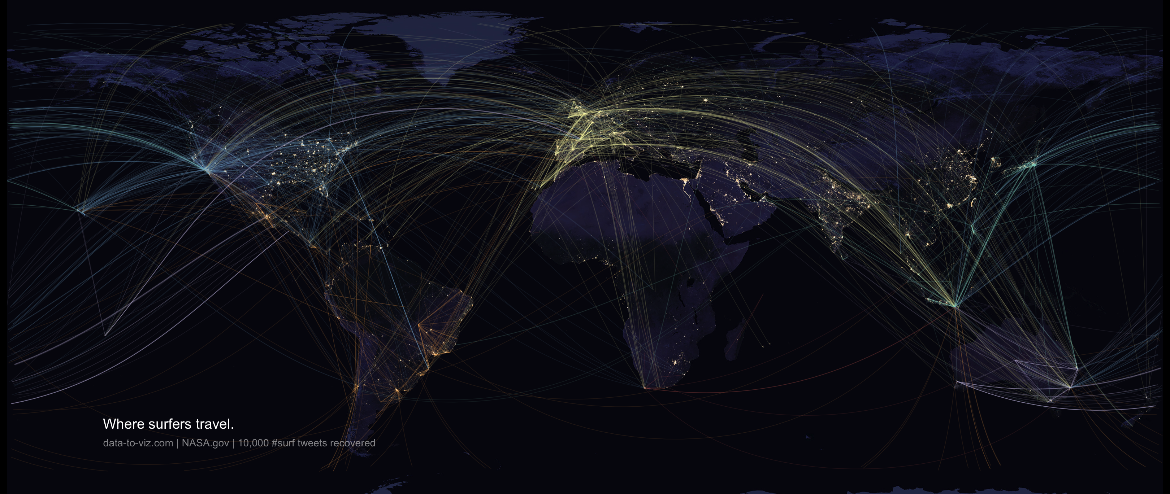
Notes:
Bespoke figures

Slide 9
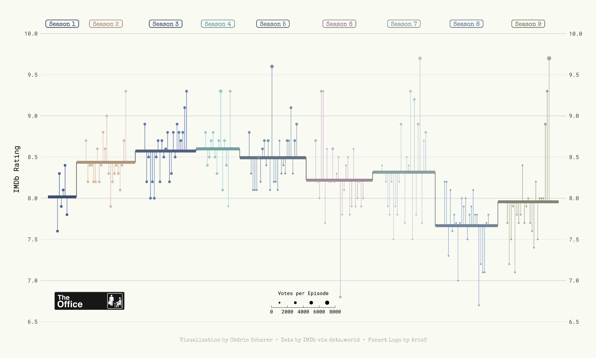

Slide 10
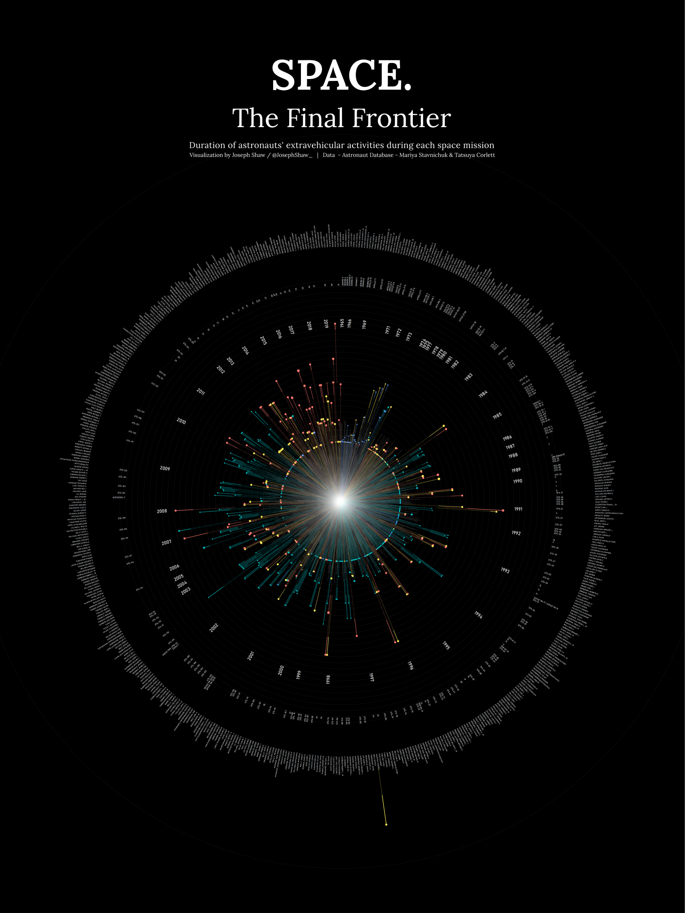
github.com/joseph-shaw/tidytuesday/

Slide 11
github.com/joseph-shaw/tidytuesday/

Slide 12
Data
ggplot(
data = yourdata
,
Aesthetics
mapping = aes(x axis, y axis)
) +
geometry function
+
Geometries
statistics function
+
Statistics
scales function
+
themes function
Scales
Themes
Notes:
method chaining with a +

Slide 13
Data
ggplot(
data = yourdata
,
Aesthetics
mapping = aes(x axis, y axis)
) +
geometry function
+
Geometries
statistics function
+
Statistics
scales function
+
themes function
Scales
Themes
Notes:
method chaining with a +

Slide 14
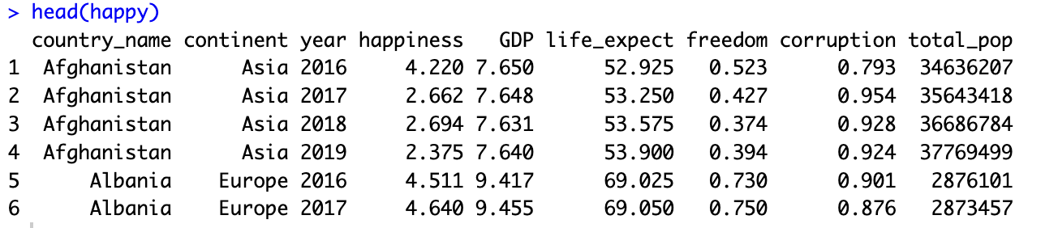
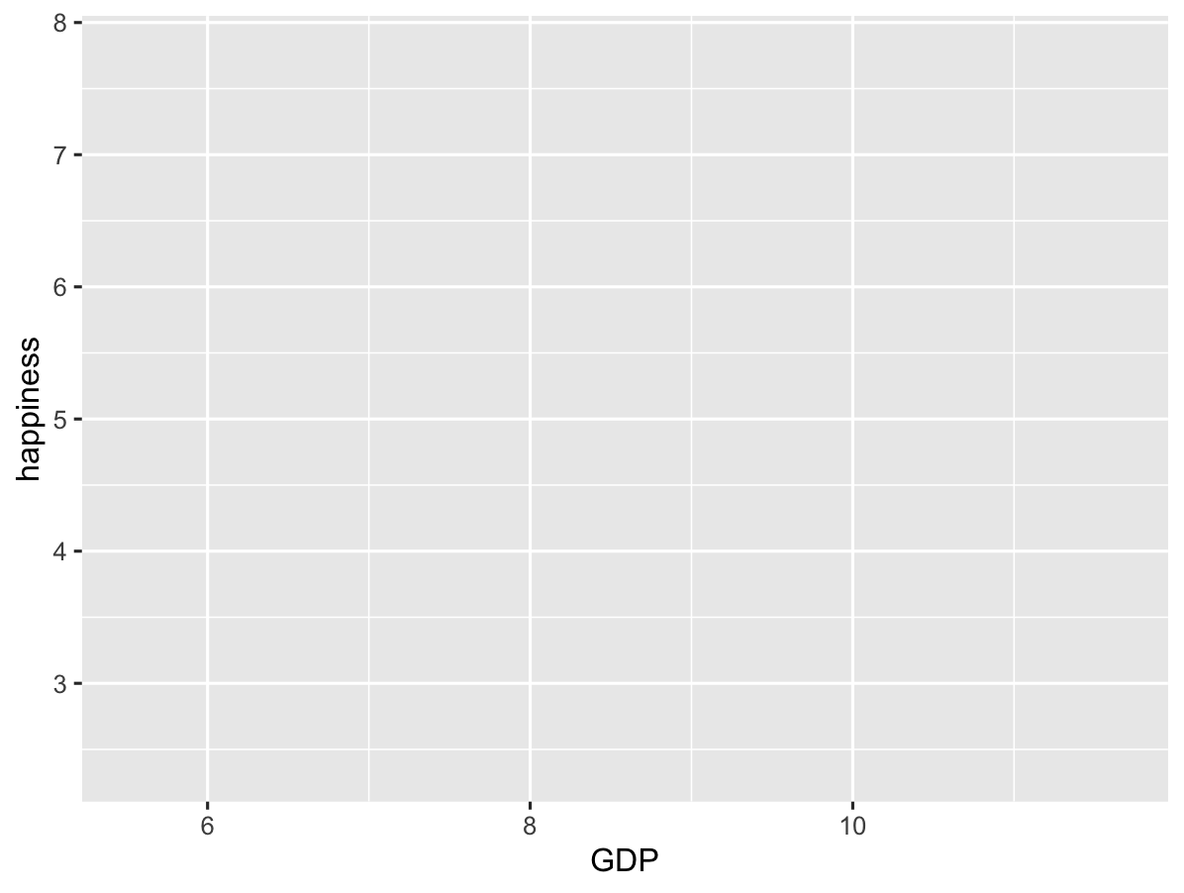
ggplot(
data = happy
,
aes(GDP, happiness)
)+
geom_point()

Slide 15
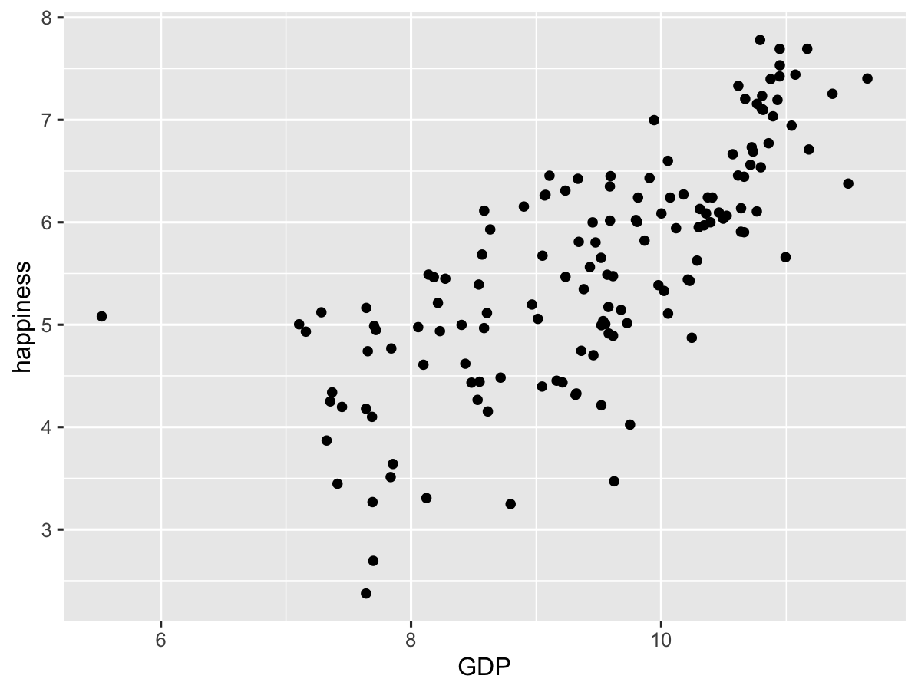
ggplot(
data = happy
,
aes(GDP, happiness)
)+
geom_point()

Slide 16
ggplot(
data = yourdata
,
mapping = aes(x axis, y axis)
) +
geometry function
Notes:
method chaining with a +

Slide 17
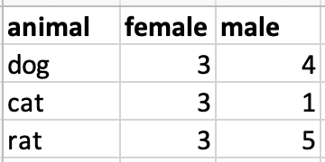
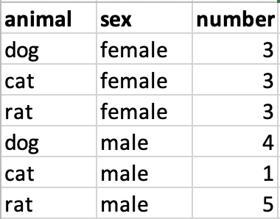
Data Format
ggplot expects your data to be in a “tidy” format
Wide data
Long data (aka “Tidy” data)

Slide 18
Data Format
ggplot expects your data to be in a “tidy” format
Wide data
Long data (aka “Tidy” data)
f

Slide 19
Data Format
Wide data
Long data
f
Long_data <- Wide_data |>
pivot_longer(names_to = sex,
values_to = number)

Slide 20
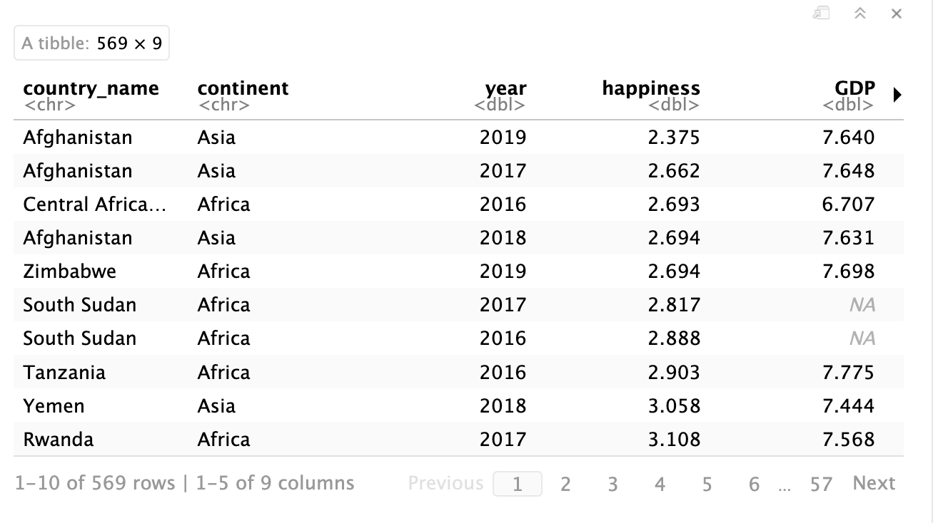
happy <- read_csv("Happiness.csv")
happy

Slide 21
happy <- read_csv("Happiness.csv")
happy

Slide 22
ggplot(
data = yourdata
,
mapping = aes(x axis, y axis)
) +
geometry function
Notes:
method chaining with a +

Slide 23
ggplot(
data = happy
,
mapping = aes(x axis, y axis)
) +
geometry function
Notes:
method chaining with a +

Slide 24
ggplot(
data = happy
,
mapping = aes(x axis, y axis)
) +
geometry function
Notes:
method chaining with a +

Slide 25
happy

Slide 26
ggplot(
data = happy
,
mapping = aes(GDP, happiness)
) +
geometry function
Notes:
method chaining with a +

Slide 27
ggplot(
data = happy
,
mapping = aes(GDP, happiness)
) +
geometry function
Notes:
method chaining with a +

Slide 28
ggplot(
data = happy
,
mapping = aes(GDP, happiness)
) +
geometry function
Notes:
method chaining with a +

Slide 29
ggplot(
data = happy
,
aes(GDP, happiness)
)+
geom_point()

Slide 30
ggplot(
data = happy
,
aes(GDP, happiness)
)+
geom_point()

Slide 31
Data
,
ggplot(
data = yourdata
,
Aesthetics
aes(x axis, y axis)
) +
Geometries
geometry function
Notes:
method chaining with a +

Slide 32
Data
,
ggplot(
data = yourdata
,
Aesthetics
aes(x axis, y axis)
) +
Geometries
geometry function
ggplot(
data = happy
,
aes(x=GDP, y=happiness)
) +
geom_point()
Notes:
method chaining with a +

Slide 33
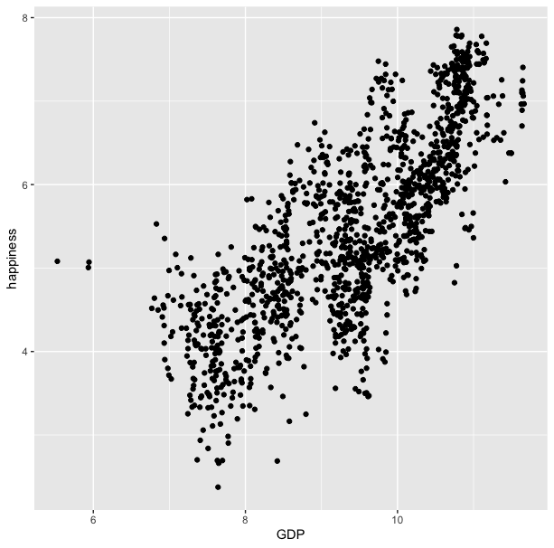
ggplot(
data = happy
,
aes(x=GDP, y=happiness)
) +
geom_point()

Slide 34
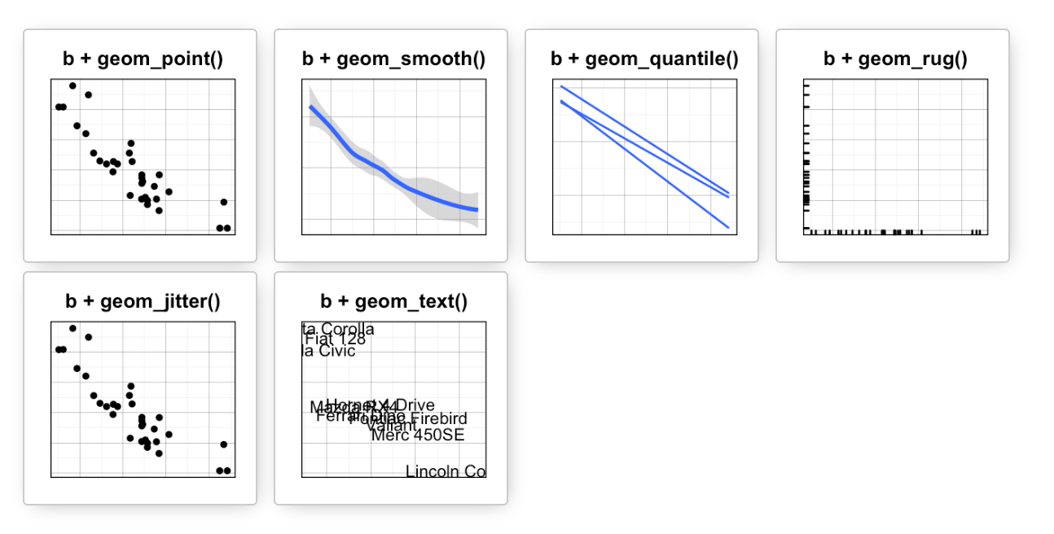
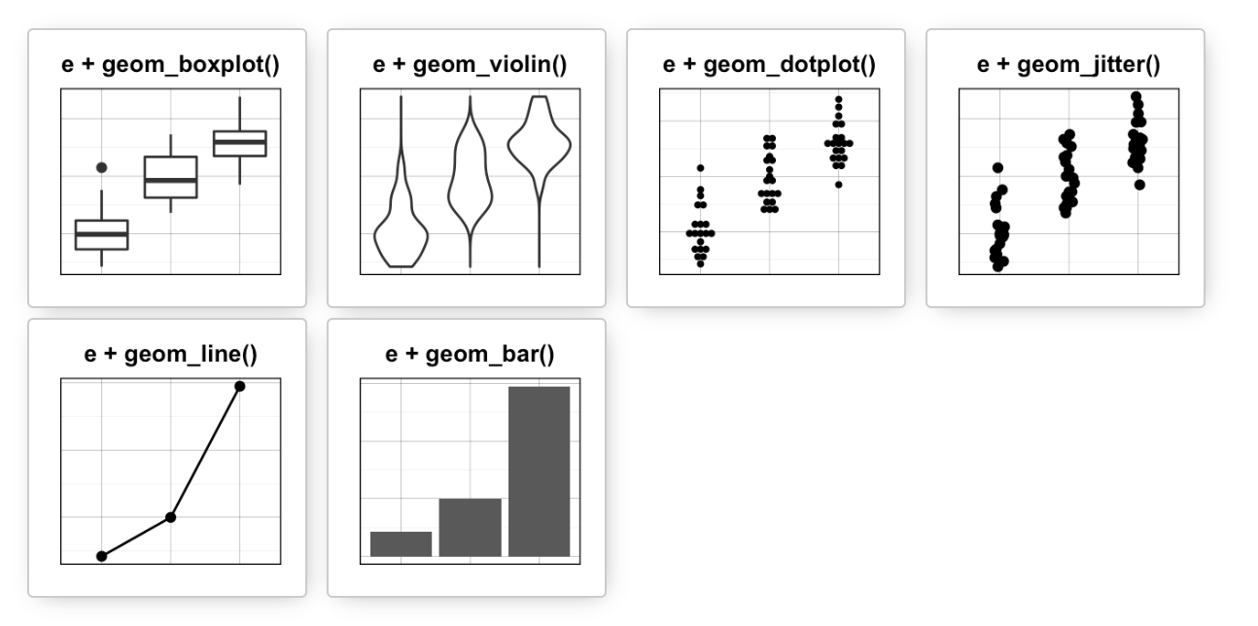
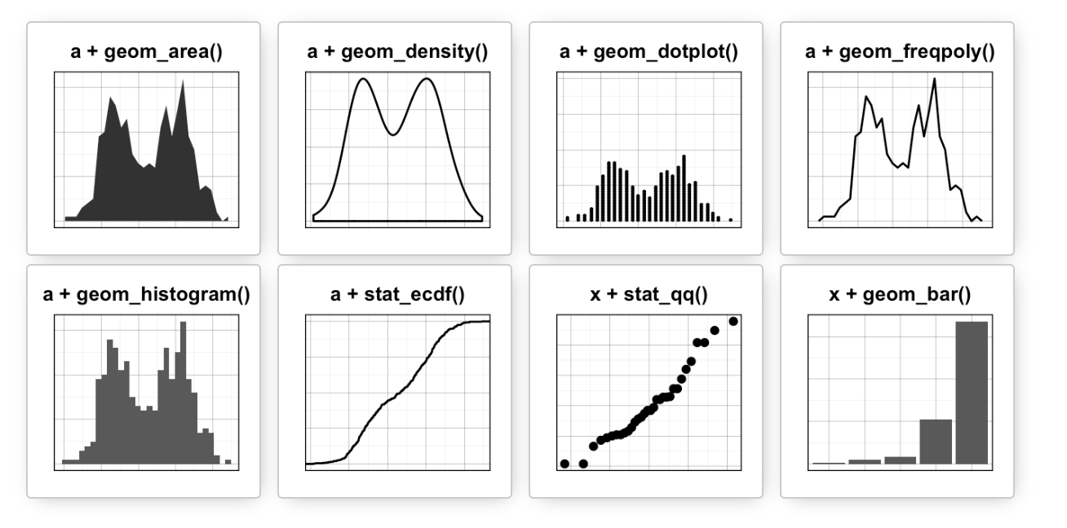
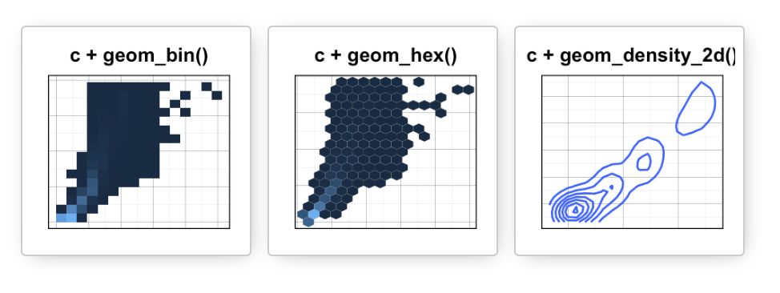
Data
Aesthetics
Geometries
Statistics
Scales
Themes
x + geom_col()
Exporting

Slide 35
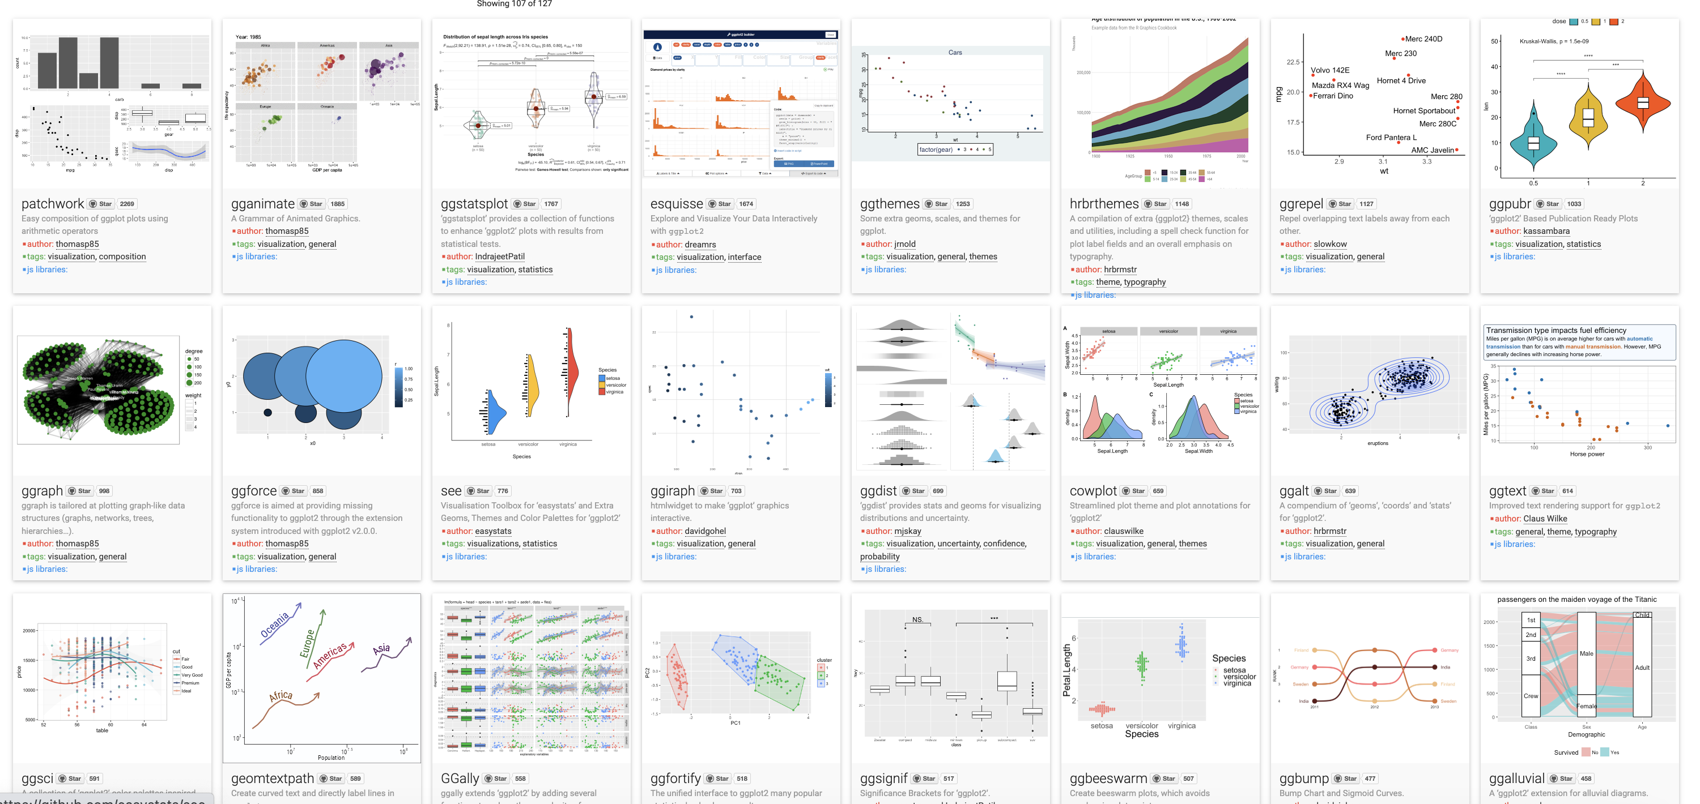
Over 120 ggplot2 extension libraries

Slide 37
Data
Aesthetics
Geometries
Statistics
Scales
Themes
x + geom_col()
Exporting

Slide 38
ggplot(
data = happy
,
mapping = aes(GDP, happiness)
) +
geom_point()
Notes:
method chaining with a +

Slide 39
ggplot(
data = happy
,
mapping = aes(GDP, happiness)
) +
geom_point()
Notes:
method chaining with a +

Slide 40
Chaining method
ggplot(
data = happy
,
mapping = aes(GDP, happiness)
) +
geom_point()
“and then…”
dplyr %>% or |>
ggplot +
Notes:
method chaining with a +

Slide 41
Chaining method
ggplot(
data = happy
,
mapping = aes(GDP, happiness)
) +
geom_point()
“and then…”
dplyr %>% or |>
ggplot +
Notes:
method chaining with a +

Slide 42
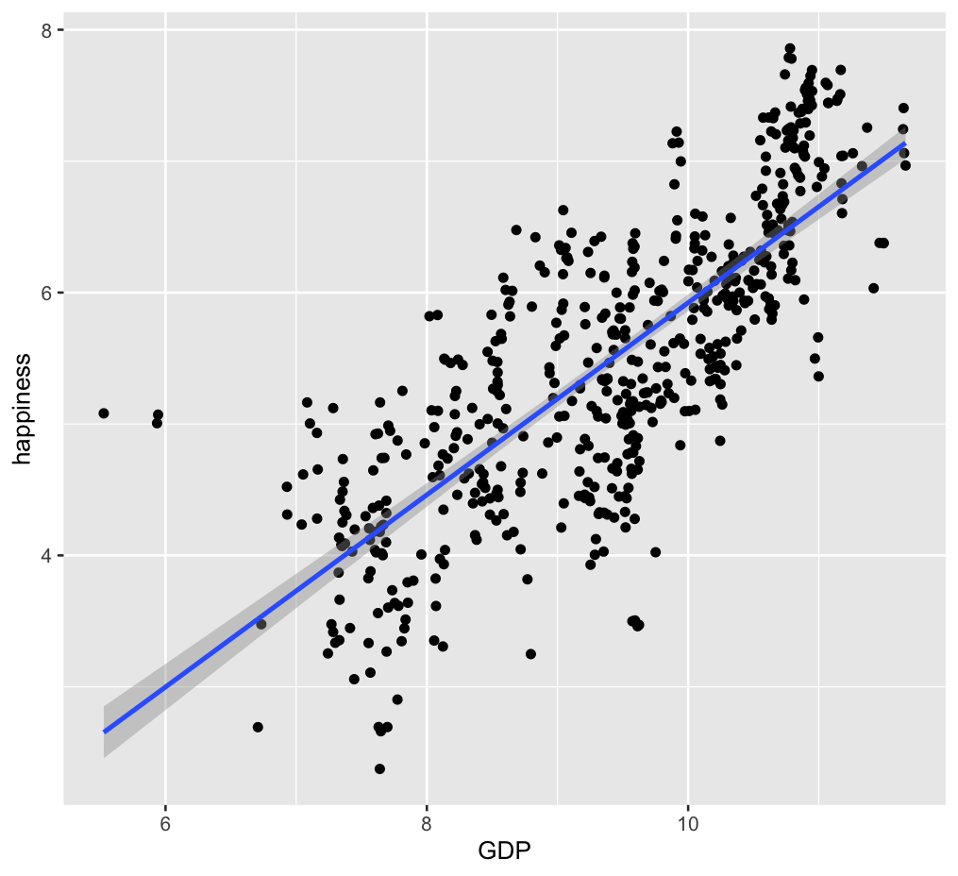
Chaining method
ggplot(
data = happy
,
mapping = aes(GDP, happiness)
) +
geom_point()
+
geom_smooth(method=“lm”)
Notes:
method chaining with a +

Slide 43
ggplot(
,
data = happy
aes(GDP, happiness)
) +
geom_point()
“and then…”
dplyr %>% or |>
ggplot +

Slide 44

ggplot(data = happy, aes(x=GDP, y=happiness))+
geom_point()

Slide 45
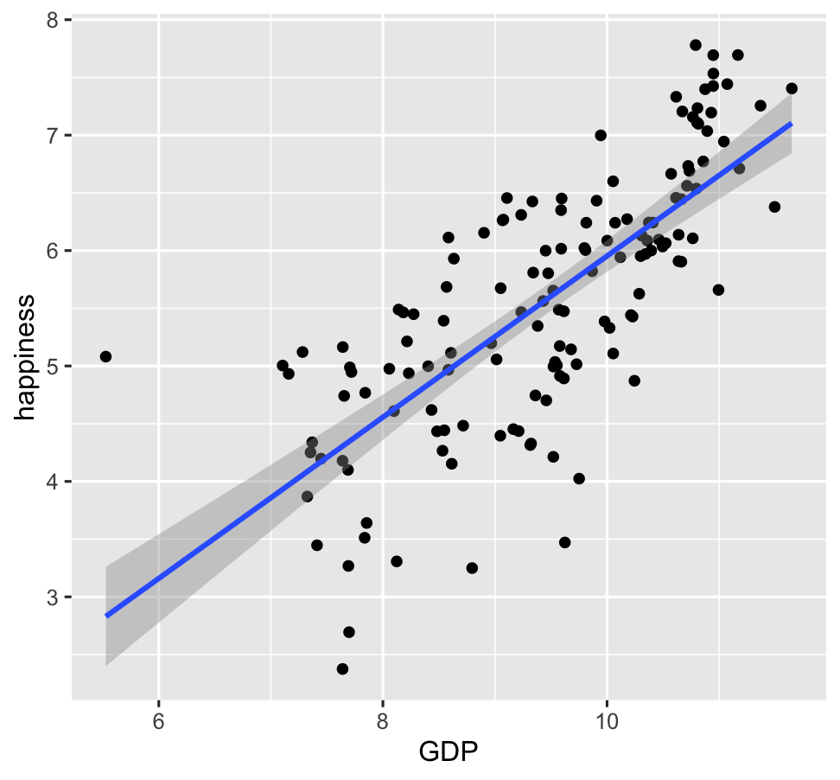
ggplot(data = happy, aes(x=GDP, y=happiness))+
geom_point()+
geom_smooth()

Slide 46
ggplot(
data = happy
,
) +
aes(x=GDP, y=happiness)
geom_point()

Slide 47
ggplot(
data = happy
,
aes(x=GDP, y=happiness)
) +
geom_point()
Notes:
ADD SLIDE BEF ORE WITHOUT Xs

Slide 48
ggplot(
data = happy
,
aes(x=GDP, y=happiness)
) +
geom_point()
ggplot(
happy
aes(GDP, happiness)
) +
,
geom_point()

Slide 49
ggplot(
data = happy
,
aes(x=GDP, y=happiness)
) +
geom_point()
ggplot(
happy
aes(GDP, happiness)
) +
,
geom_point()
ggplot(
) +
geom_point(
happy
aes(GDP, happiness)
,
)

Slide 50
ggplot(
data = happy
,
aes(x=GDP, y=happiness)
) +
geom_point()
ggplot(
happy
aes(GDP, happiness)
) +
,
geom_point()
ggplot(
) +
geom_point(
happy
aes(GDP, happiness)
,
)
,
happy
%>%
ggplot(
aes(GDP, happiness)
) +
geom_point()

Slide 51
ggplot(
data = happy
,
aes(x=GDP, y=happiness)
) +
geom_point()
ggplot(
happy
aes(GDP, happiness)
) +
,
geom_point()
ggplot(
) +
geom_point(
happy
aes(GDP, happiness)
,
)
,
happy
%>%
ggplot(
aes(GDP, happiness)
) +
geom_point()
These all produce the same figure!

Slide 52
Aesthetics define any data that gets mapped to geometry
(such as color, size, shape, etc.)
ggplot(data = yourData,
aes(x = xaxis,y = yaxis))+
geom_point()
Notes:
method chaining with a +

Slide 53
Aesthetics define any data that gets mapped to geometry
(such as color, size, shape, etc.)
ggplot(data = happy,
aes(x = happiness,y = GDP,
shape= ,
size= ,
col= ))+
geom_point()
Notes:
method chaining with a +

Slide 55
ggplot(happy, aes(GDP, happiness)) +
geom_point()

Slide 56
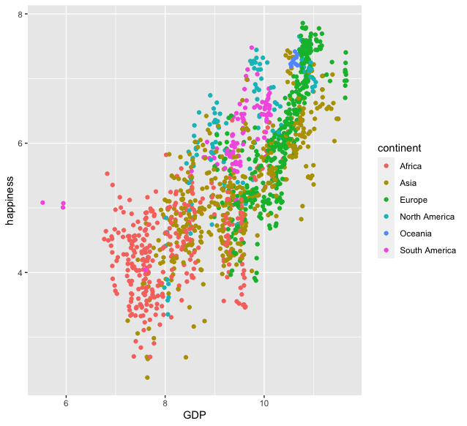
ggplot(happy, aes(GDP, happiness)) +
geom_point(aes(col=continent))

Slide 57
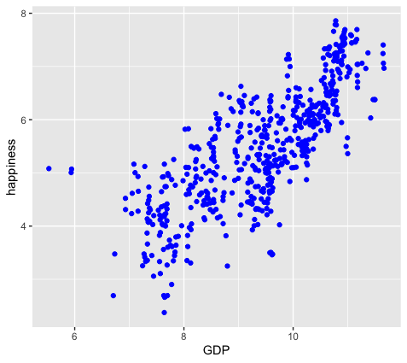
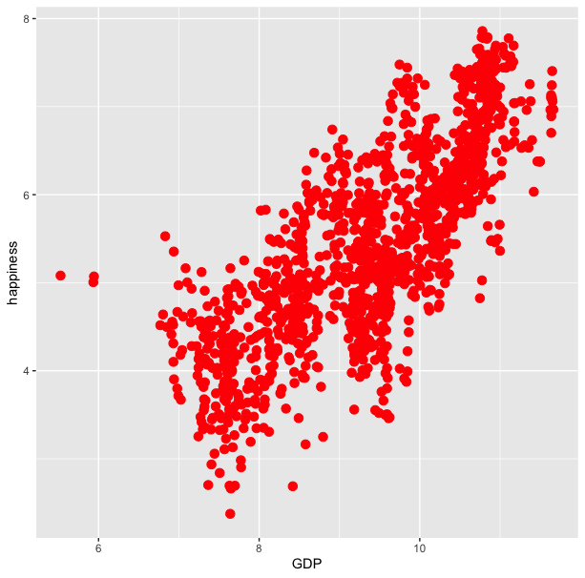
ggplot(happy, aes(GDP, happiness)) +
geom_point(aes(col=continent))
ggplot(happy, aes(GDP, happiness)) +
geom_point(col=‘blue’)

Slide 58
ggplot(happy, aes(GDP, happiness)) +
geom_point(aes(col=continent))
ggplot(happy, aes(GDP, happiness)) +
geom_point(col=‘blue’)
ggplot(happy, aes(GDP, happiness)) +
geom_point(aes(col=‘blue’))

Slide 59
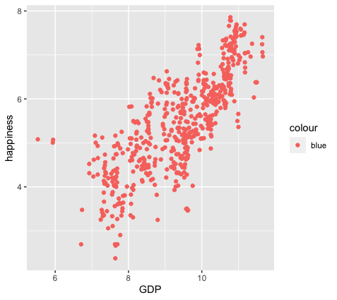
ggplot(happy, aes(GDP, happiness)) +
geom_point(aes(col=continent))
ggplot(happy, aes(GDP, happiness)) +
geom_point(col=‘blue’)
ggplot(happy, aes(GDP, happiness)) +
geom_point(aes(col=‘blue’))
?!?

Slide 60
colour
blue
blue
blue
blue
blue
blue
ggplot(happy, aes(GDP, happiness)) +
geom_point(aes(col=‘blue’))

Slide 61
ggplot(happy, aes(GDP, happiness)) +
geom_point()
We can also set conditional formatting.
e.g. Use different colors for points where happiness is > 5

Slide 62
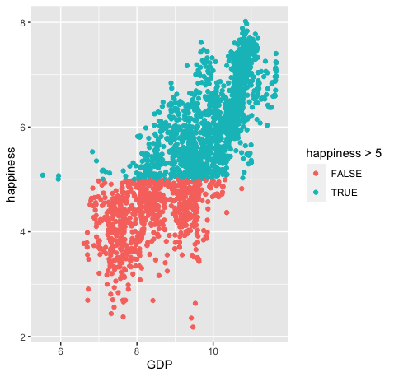
ggplot(happy, aes(GDP, happiness)) +
geom_point()
ggplot(happy, aes(GDP, happiness)) +
geom_point(aes(col=happiness > 5)

Slide 63
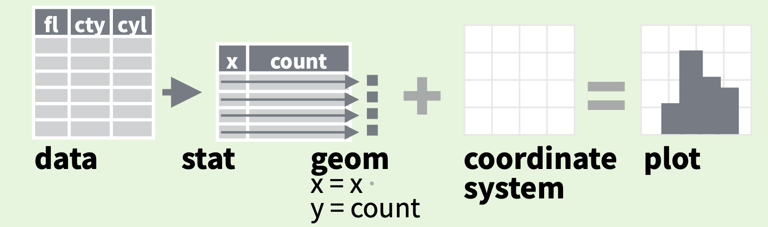
stats
Every geom function specifies a stat
Data
Aesthetics
Geometries
Statistics
Scales
Themes
Exporting

Slide 64
Data
Aesthetics
Geometries
Statistics
Scales
Themes
x + geom_col()
Exporting

Slide 65
Data
Aesthetics
Geometries
Statistics
Scales
Themes
x + geom_col()
Exporting

Slide 66
Task: For the year 2019, count the number of observations per continent in our dataset.
Then plot this as a bar chart.

Slide 67
Task: For the year 2019, count the number of observations per continent in our dataset.
Then plot this as a bar chart.
happy

Slide 68
Task: For the year 2019, count the number of observations per continent in our dataset.
Then plot this as a bar chart.
happy |>
filter(year == 2019)

Slide 69
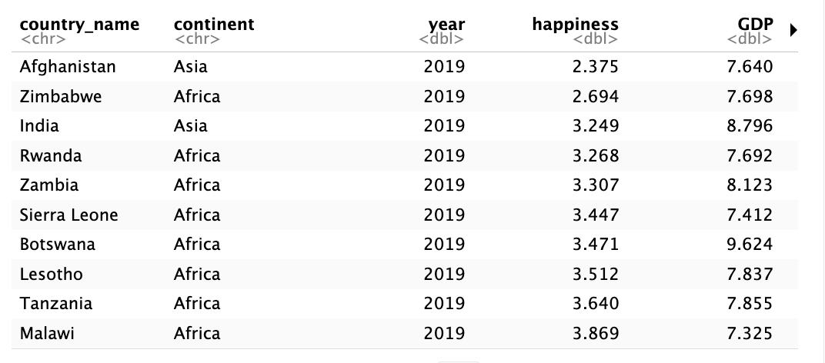
Task: For the year 2019, count the number of observations per continent in our dataset.
Then plot this as a bar chart.
happy |>
filter(year == 2019)

Slide 70
Task: For the year 2019, count the number of observations per continent in our dataset.
Then plot this as a bar chart.
happy |>
filter(year == 2019) |>
group_by(continent)

Slide 71
Task: For the year 2019, count the number of observations per continent in our dataset.
Then plot this as a bar chart.
happy |>
filter(year == 2019) |>
group_by(continent) |>
summarize(n=n())

Slide 72
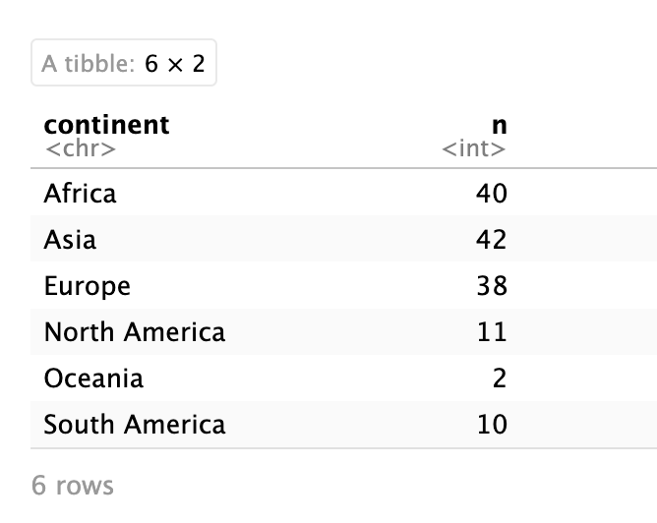
Task: For the year 2019, count the number of observations per continent in our dataset.
Then plot this as a bar chart.
happy |>
filter(year == 2019) |>
group_by(continent) |>
summarize(n=n())

Slide 73
Task: For the year 2019, count the number of observations per continent in our dataset.
Then plot this as a bar chart.
happy |>
filter(year == 2019) |>
group_by(continent) |>
summarize(n=n()) |>
ggplot( )

Slide 74
Task: For the year 2019, count the number of observations per continent in our dataset.
Then plot this as a bar chart.
happy |>
filter(year == 2019) |>
group_by(continent) |>
summarize(n=n()) |>
ggplot(aes(continent, n)

Slide 75
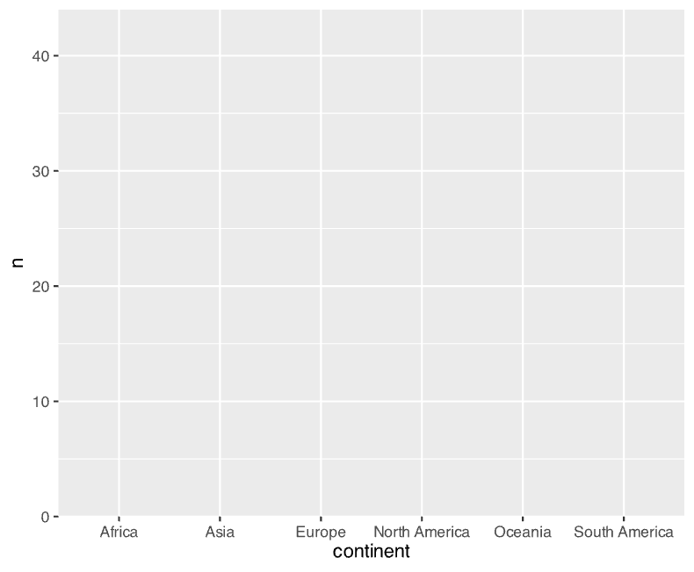
Task: For the year 2019, count the number of observations per continent in our dataset.
Then plot this as a bar chart.
happy |>
filter(year == 2019) |>
group_by(continent) |>
summarize(n=n()) |>
ggplot(aes(continent, n)

Slide 76
Task: For the year 2019, count the number of observations per continent in our dataset.
Then plot this as a bar chart.
happy |>
filter(year == 2019) |>
group_by(continent) |>
summarize(n=n()) |>
ggplot(aes(continent, n) +
geom_col()

Slide 77
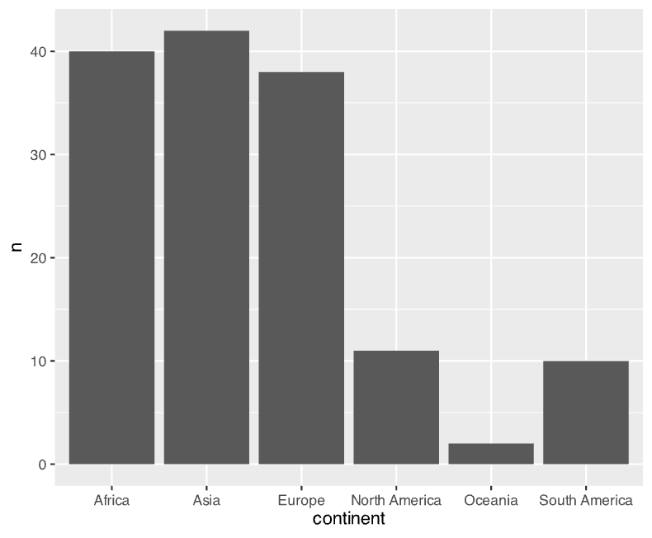
Task: For the year 2019, count the number of observations per continent in our dataset.
Then plot this as a bar chart.
happy |>
filter(year == 2019) |>
group_by(continent) |>
summarize(n=n()) |>
ggplot(aes(continent, n) +
geom_col()

Slide 78
stats
Every geom function specifies a stat
Notes:
For example: If we wanted to make a bar plot that shows how frequently each of the continents is represented in our dataset.

Slide 79
stats
Every geom function specifies a stat
ggplot(happy, aes(continent)) +
geom_bar()
Notes:
ADD INFO ABOUT THE SILENT STAT=SUM

Slide 80
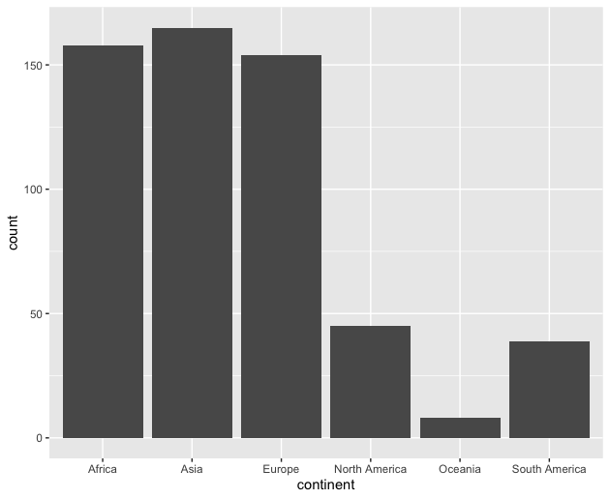
stats
Every geom function specifies a stat
ggplot(happy, aes(continent)) +
geom_bar()

Slide 81
Data
ggplot(
data = yourdata
,
Aesthetics
mapping = aes(x axis, y axis)
) +
geometry function
+
Geometries
statistics function
+
Statistics
scales function
+
themes function
Scales
Themes
Exporting
Notes:
method chaining with a +

Slide 82
Scales
Data
Scales permeate all aspects of plotting in ggplot2
Most defaults will be enough
BUT learning how to manipulate them will give you much more control.
Aesthetics
Geometries
Statistics
Scales
Themes
Exporting

Slide 83
Scales
Data
Scales permeate all aspects of plotting in ggplot2
Most defaults will be enough
BUT learning how to manipulate them will give you much more control.
Aesthetics
Geometries
Statistics
Scales
Themes
Exporting

Slide 84
Scales
Data
Scales permeate all aspects of plotting in ggplot2
Most defaults will be enough
BUT learning how to manipulate them will give you much more control.
Aesthetics
Geometries
Statistics
Scales
Themes
Exporting

Slide 85
Three kinds of scales you are most likely to use:
Axes Limits
Bins
Colors

Slide 86
Three kinds of scales you are most likely to use:
Axes Limits
Bins
Colors
I’ll cover these during the live demo portion

Slide 87
Three kinds of scales you are most likely to use:
Axes Limits
Bins
Colors
I want to spend some time talking about color scales

Slide 88
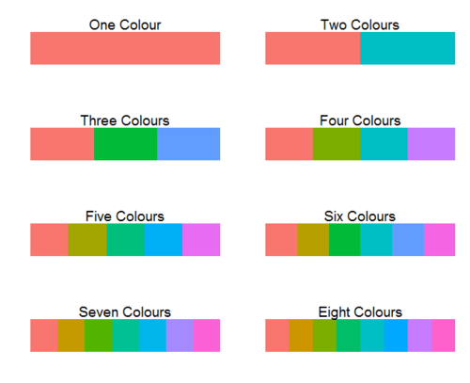
ggplot2 default colors for factors

Slide 89
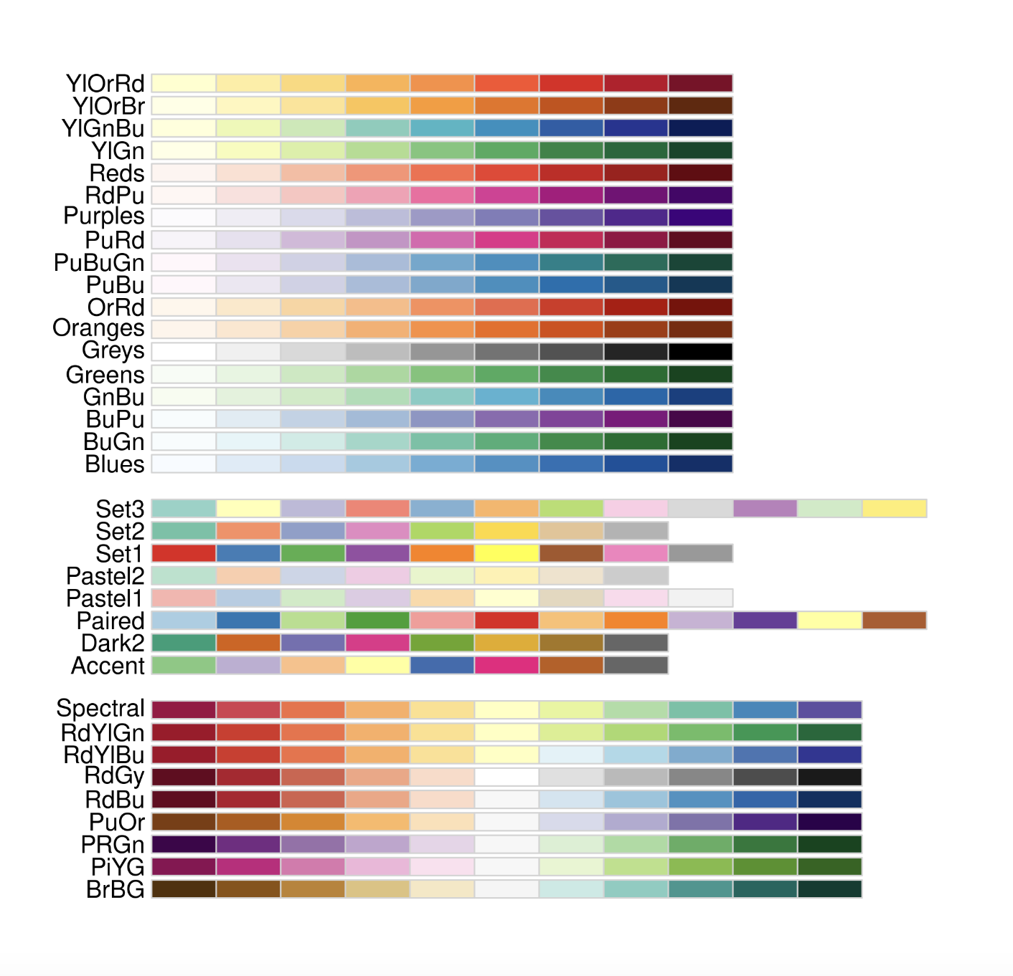
Brewer Scales
Monochrome scales
Qualitative scales
Divergent color scales
Notes:
ADD IMAGE OF DEFAULT COLOR SCALE

Slide 90
happy |>
filter(year == 2019) |>
group_by(continent) |>
summarize(n=n()) |>
ggplot(aes(continent, n) +
geom_col()

Slide 91
happy |>
filter(year == 2019) |>
group_by(continent) |>
summarize(n=n()) |>
ggplot(aes(continent, n) +
geom_col(aes(fill=continent=="Asia")

Slide 92
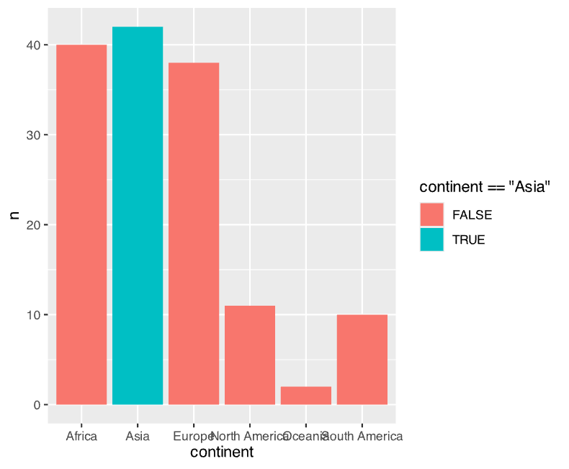
happy |>
filter(year == 2019) |>
group_by(continent) |>
summarize(n=n()) |>
ggplot(aes(continent, n) +
geom_col(aes(fill=continent=="Asia"))

Slide 93
Brewer Scales
Monochrome scales
Qualitative scales
Divergent color scales
Notes:
ADD IMAGE OF DEFAULT COLOR SCALE

Slide 94
happy |>
filter(year == 2019) |>
group_by(continent) |>
summarize(n=n()) |>
ggplot(aes(continent, n) +
geom_col(aes(fill=continent=="Asia") +
scale_fill_brewer(palette='Accent')

Slide 95
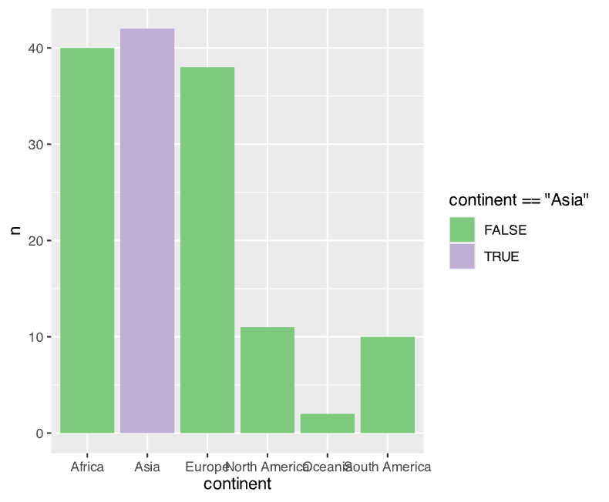
happy |>
filter(year == 2019) |>
group_by(continent) |>
summarize(n=n()) |>
ggplot(aes(continent, n) +
geom_col(aes(fill=continent=="Asia") +
scale_fill_brewer(palette='Accent')

Slide 96

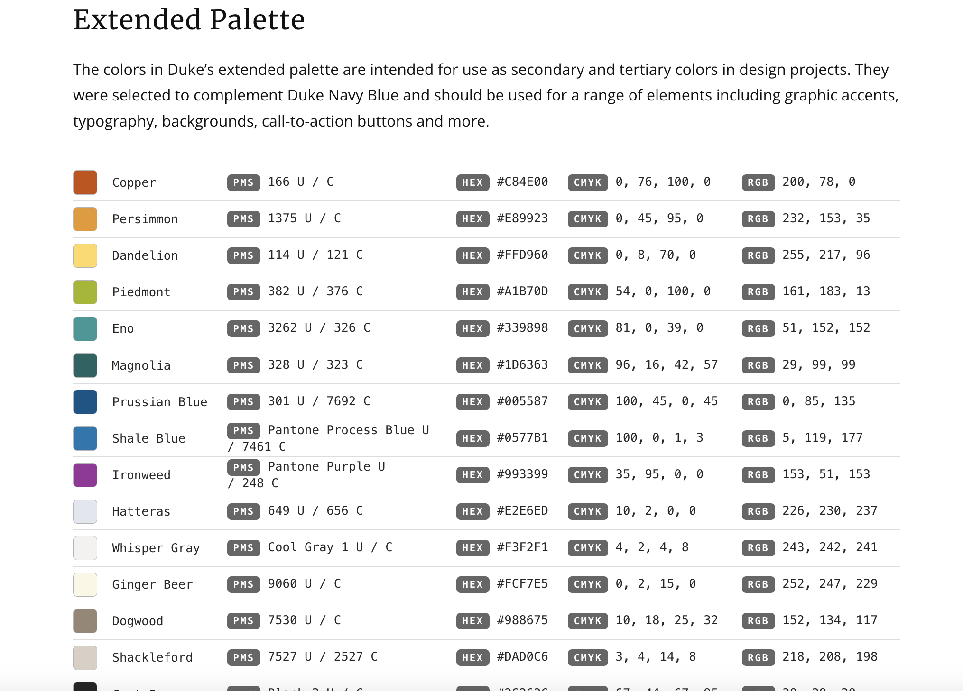
http://brand.duke.edu/colors

Slide 97

http://brand.duke.edu/colors

Slide 98


Slide 99
happy |>
filter(year == 2019) |>
group_by(continent) |>
summarize(n=n()) |>
ggplot(aes(continent, n) +
geom_col(aes(fill=continent=="Asia") +
scale_fill_brewer(palette='Accent')

Slide 100
happy |>
filter(year == 2019) |>
group_by(continent) |>
summarize(n=n()) |>
ggplot(aes(continent, n) +
geom_col(aes(fill=continent=="Asia") +
scale_fill_manual(values = DukeColors)

Slide 101
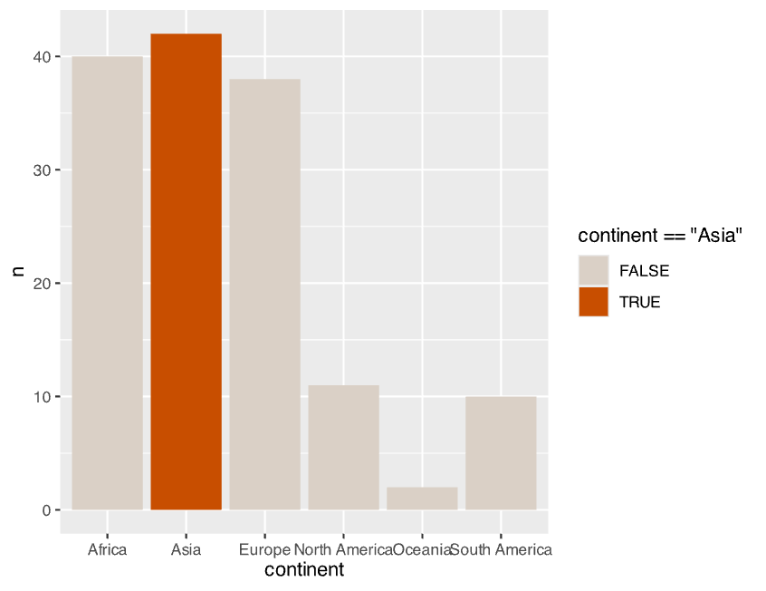
happy |>
filter(year == 2019) |>
group_by(continent) |>
summarize(n=n()) |>
ggplot(aes(continent, n) +
geom_col(aes(fill=continent=="Asia") +
scale_fill_manual(values = DukeColors)

Slide 102
Data
Aesthetics
Geometries
Statistics
Scales
Themes
Exporting

Slide 103
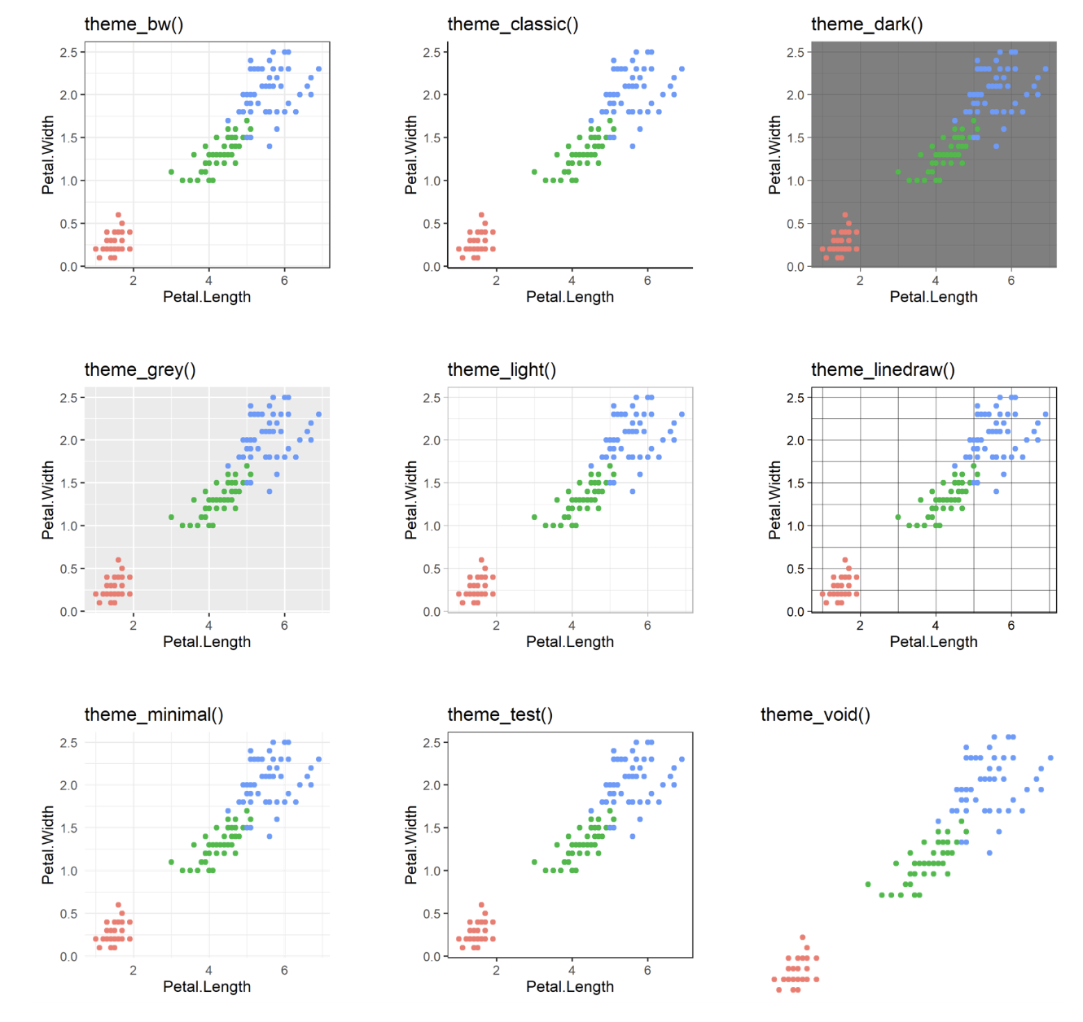
60 preexisting themes
easy to call
Data
Aesthetics
Geometries
Statistics
Scales
Themes
Exporting

Slide 104
happy |>
filter(year == 2019) |>
group_by(continent) |>
summarize(n=n()) |>
ggplot(aes(continent, n) +
geom_col(aes(fill=continent=="Asia") +
scale_fill_manual(value = DukeColors)+
theme_minimal()

Slide 105
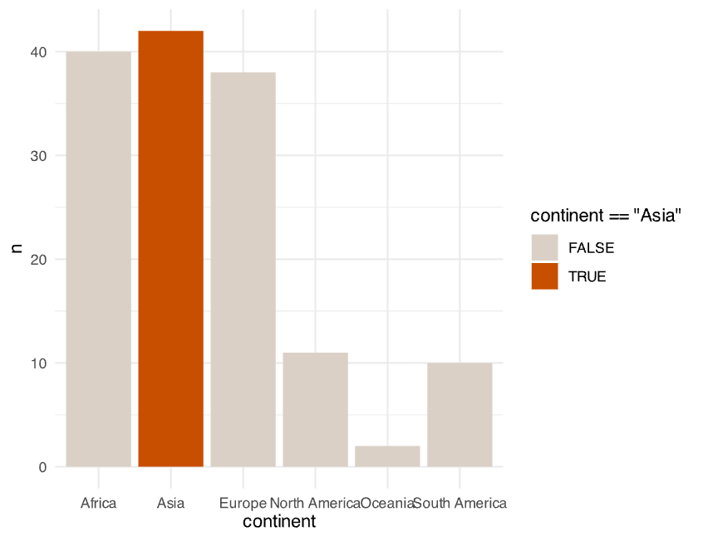
happy |>
filter(year == 2019) |>
group_by(continent) |>
summarize(n=n()) |>
ggplot(aes(continent, n) +
geom_col(aes(fill=continent=="Asia") +
scale_fill_manual(value = DukeColors)+
theme_minimal()

Slide 106
60 preexisting themes
easy to call
Data
Aesthetics
Geometries
Statistics
Scales
Themes
Exporting

Slide 107
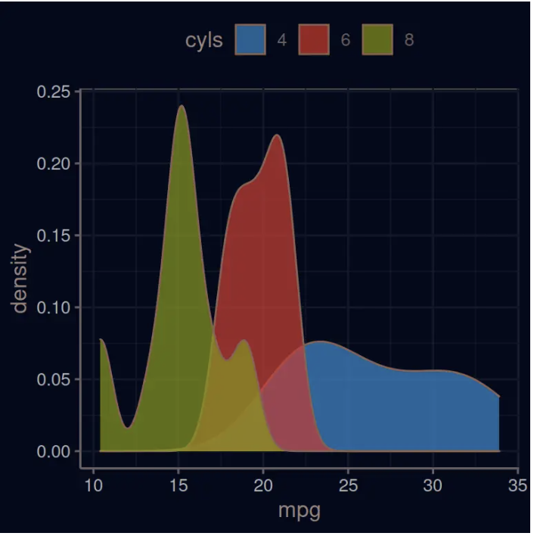
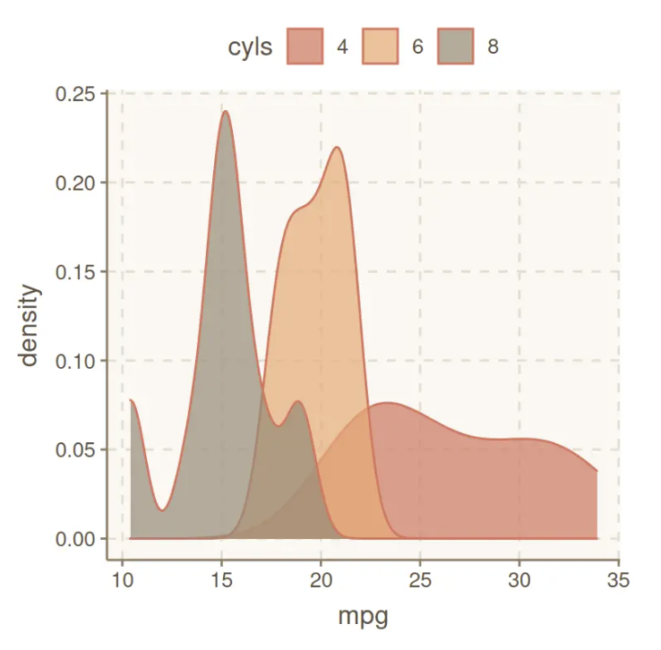
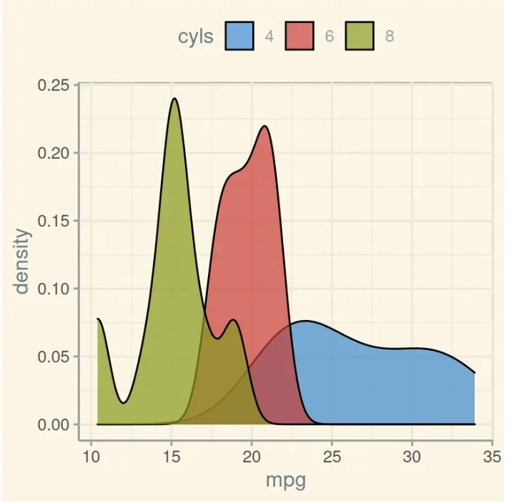
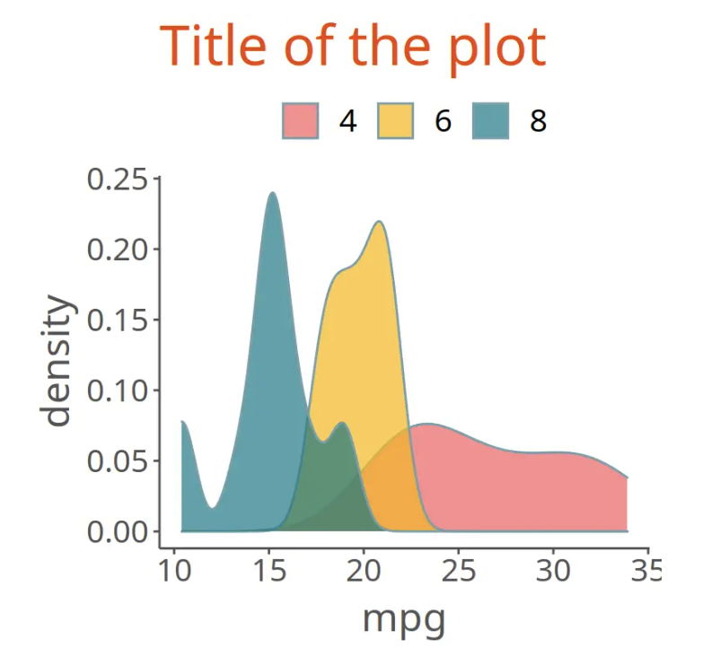
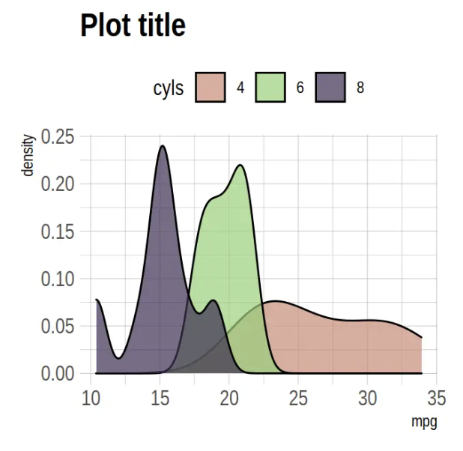
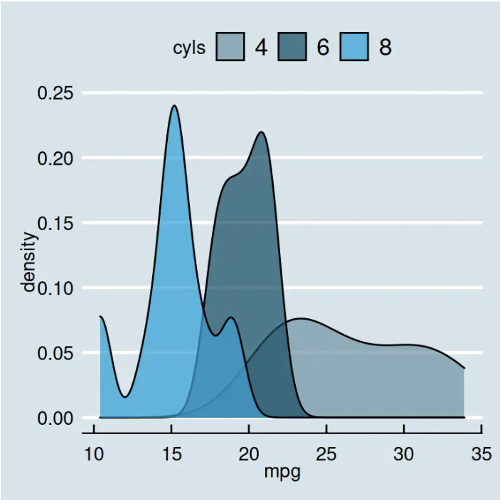
Over 60 pre-existing themes
Data
Aesthetics
Geometries
Statistics
Scales
Themes
Exporting
https://r-charts.com/ggplot2/themes/

Slide 108
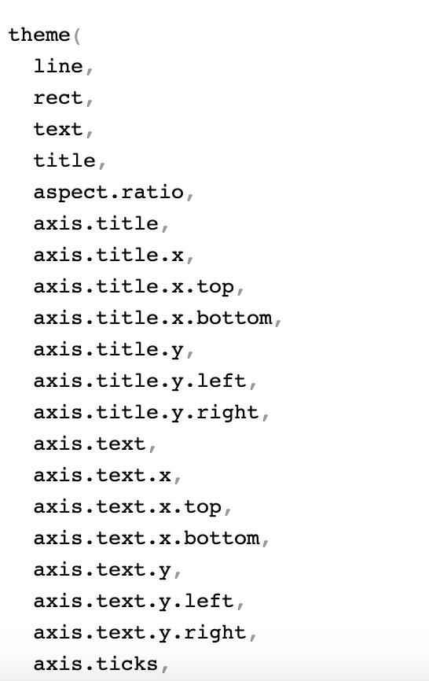
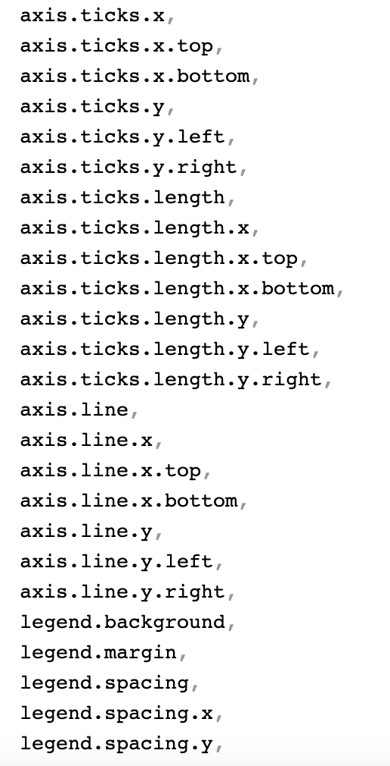
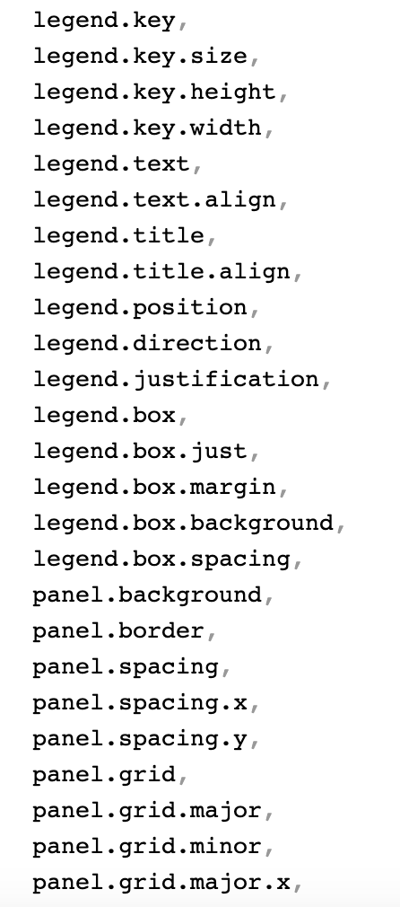
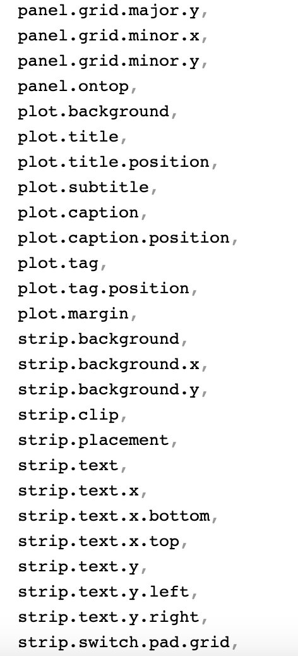
?theme()
…

Slide 109
happy |>
filter(year == 2019) |>
group_by(continent) |>
summarize(n=n()) |>
ggplot(aes(continent, n) +
geom_col(aes(fill=continent=="Asia") +
scale_fill_manual(value = DukeColors)+
theme_minimal()

Slide 110
happy |>
filter(year == 2019) |>
group_by(continent) |>
summarize(n=n()) |>
ggplot(aes(continent, n) +
geom_col(aes(fill=continent=="Asia") +
scale_fill_manual(value = DukeColors)+
theme_minimal() +
theme(
axis.line.x.bottom=element_line(),
axis.line.y.left=element_line()
)

Slide 111

happy |>
filter(year == 2019) |>
group_by(continent) |>
summarize(n=n()) |>
ggplot(aes(continent, n) +
geom_col(aes(fill=continent=="Asia") +
scale_fill_manual(value = DukeColors)+
theme_minimal() +
theme(
axis.line.x.bottom=element_line(),
axis.line.y.left=element_line()
)

Slide 112
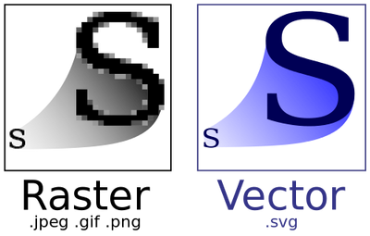
Data
Aesthetics
Geometries
Statistics
Scales
.pdf
Themes
Exporting

Slide 113


Slide 114
Lets give it a try
https://tinyurl.com/ggplot2mids

Slide 115


